Slide 1

Mental Health in Tech Workers

Slide 2
Title: Mental Health in Tech Workers
Subtitle: A Data-Driven Analysis of the 2019 OSMI Survey
Name: Iradukunda kubana christian
ID:27143
Date:04/08/2025

Slide 3
Introduction
This capstone project investigates mental health challenges among tech workers by analyzing data from the 2019 OSMI (Open Sourcing Mental Illness) survey. The goal is to understand how demographic factors such as age, gender, and location, as well as workplace conditions like company size and mental health policies, affect the likelihood of individuals seeking mental health treatment. Through this analysis, we aim to uncover patterns and disparities that can inform better support systems within the tech industry.
Using Python, we performed exploratory data analysis (EDA) to clean, visualize, and interpret the data. We then developed predictive models to identify key factors associated with treatment-seeking behavior. These insights can support employers and policy-makers in creating more inclusive and mentally healthy work environments. The project highlights the importance of data-driven approaches to address mental health stigma and accessibility in the tech workforce.

Slide 4

Project Overview
Methodology:
Exploratory Data Analysis (EDA): Analyzed patterns, trends, and outliers in the data.
Predictive Modeling:
Random Forest
Logistic Regression
Data Visualization: Created interactive dashboards and visual insights using Power BI.
Tools Used:
Python (for data processing and modeling)
Power BI (for interactive visualizations)
In this project, we started with Exploratory Data Analysis to understand the structure and quality of our data. Then, we applied two predictive models — Random Forest for its accuracy and robustness, and Logistic Regression for interpretability. Finally, we visualized the results using Power BI to communicate findings clearly to stakeholders. Python was our main tool for data handling and modeling, while Power BI made the insights easy to explore.

Slide 5
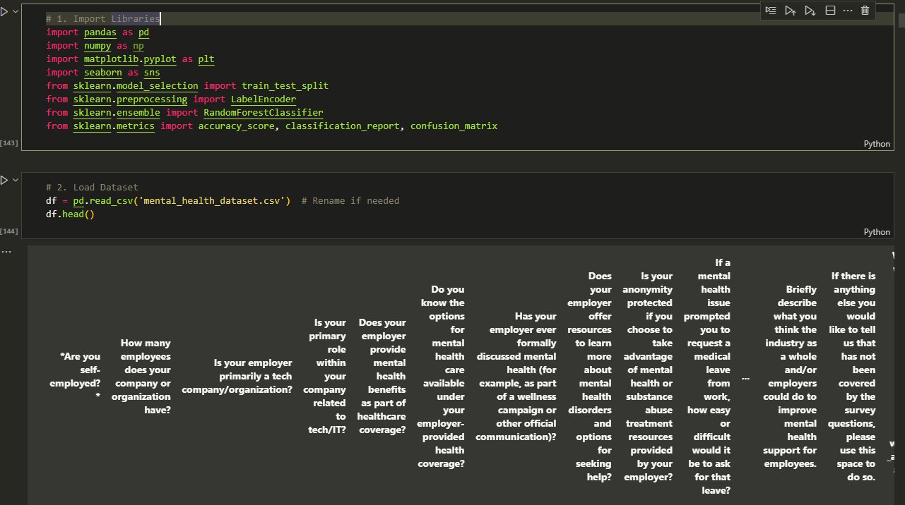
Exploratory Data Analysis
- Initial inspection and missing values
- Age and gender distribution
- Treatment-seeking by demographics

Slide 6
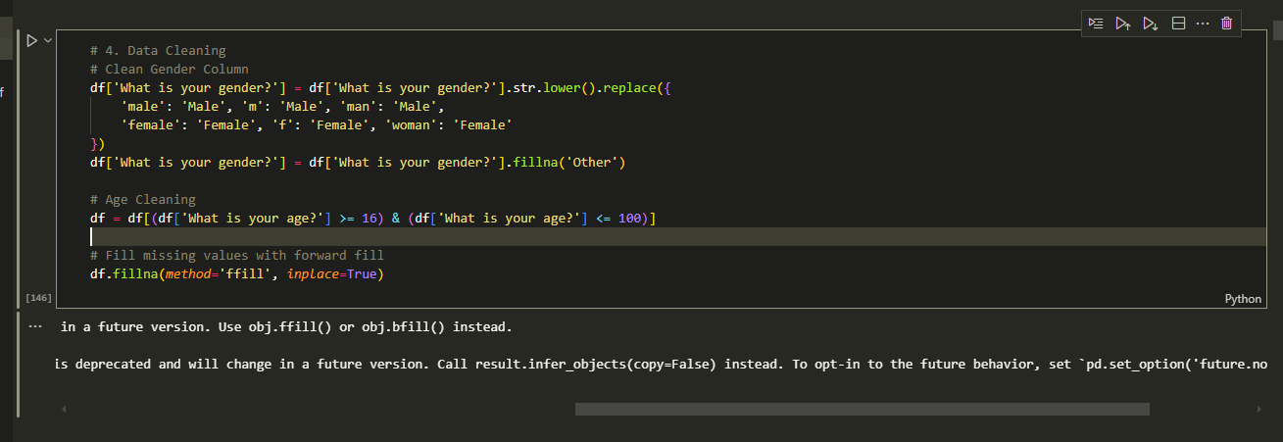
Data Cleaning Process
Standardized gender responses
Handled unrealistic ages
Filled or removed missing values

Slide 7
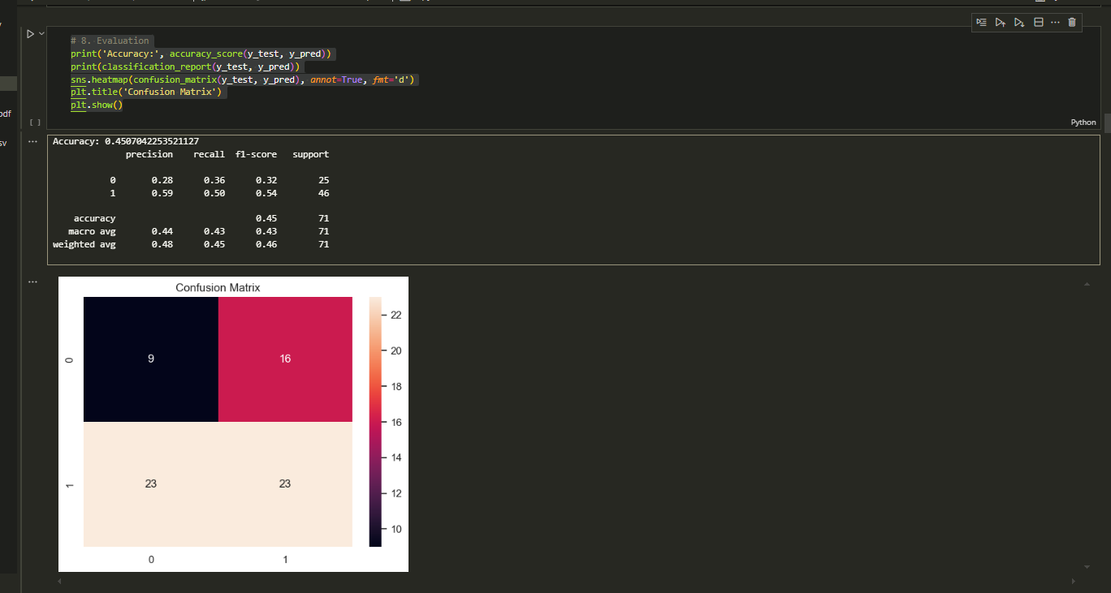
Predictive Modeling: Random Forest
Feature importance
- Confusion matrix
- Performance metrics

Slide 8
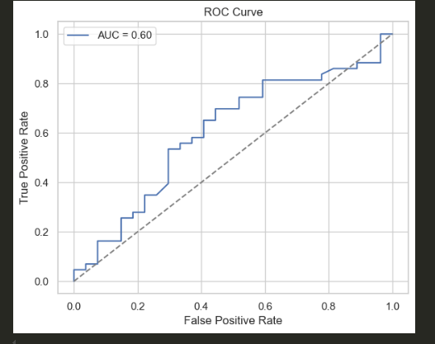
Predictive Modeling: Logistic Regression
ROC curve
Accuracy and precision scores

Slide 9
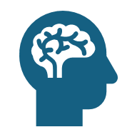
Key Findings
Gender and age influence likelihood to seek treatment
Company size and employer support matter
Work interference is higher when mental health is untreated
Mental health benefits awareness varies by location

Slide 10
Power BI Dashboard Highlights
Gender distribution
Country-wise comparison
Employer support vs diagnosis
Age vs coverage awareness
You can access the project analysis by clicking [here](). and
https://drive.google.com/file/d/1QVSvcYOlNhuV6UGtFsorTJGQqDjzunv1/view?usp=sharing
You can access the final project dashboard by clicking [here]()
https://drive.google.com/file/d/1QVSvcYOlNhuV6UGtFsorTJGQqDjzunv1/view?usp=sharing

Slide 11

Conclusion & Recommendations
Mental health remains a critical yet often overlooked aspect of employee well-being in the tech industry. Our analysis of the 2019 OSMI survey highlights that demographic variables such as gender and age, along with workplace factors like company size and employer support, significantly influence whether individuals seek treatment. Despite growing awareness, many employees still face stigma and lack of proper support structures at work, resulting in untreated conditions that interfere with productivity and overall well-being.
To address these challenges, we recommend that tech companies actively develop inclusive mental health policies, provide training for managers, and ensure confidential access to mental health services. Data-driven strategies—like using analytics to monitor employee needs—can guide the creation of supportive environments that reduce stigma and encourage early treatment. This not only benefits employees but also enhances organizational performance and retention.

